Slide 1
Capacity Planning and Optimization
ELEC 457
Ben Wilkinson

Slide 2
What is capacity planning?
Forecasting Demand
What are the expected energy and capacity requirements in 5, 10, and 15 years? Capacity (MW) and Energy (MWh) both need to be considered
Optimizing Generation Mix
Gas generators, Solar, Wind, Hydro, Batteries, etc. for capital cost, fuel and operating risk, and project life
Infrastructure Upgrade Requirements
Meeting Environmental Goals
Low or zero carbon emissions
Mitigating Risks
Unable to supply the required demand
Increased and unexpected costs

Slide 3
Optimization Software Choice
PyPSA used as optimization tool for capacity planning
Provides extensive documentation and examples for users
Built to model and optimize many different power systems efficiently
Compatible with plenty of solvers (GLPK, highs, pyomo, etc.)
Electrical objective and constraint equations built into the package

Slide 4
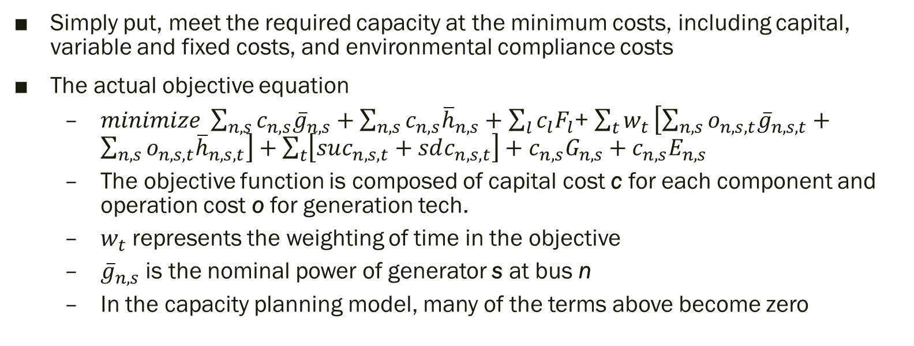
Objective function
Simply put, meet the required capacity at the minimum costs, including capital, variable and fixed costs, and environmental compliance costs
The actual objective equation
$minimize \sum_{n,s}{c_{n,s}{\overline{g}}_{n,s}}+\sum_{n,s}{c_{n,s}{\overline{h}}_{n,s}}+\sum_{l}{c_{l}F_{l}}$+ $\sum_{t}{w_{t}}\left[\sum_{n,s}{o_{n,s,t}{\overline{g}}_{n,s,t}}+\sum_{n,s}{o_{n,s,t}{\overline{h}}_{n,s,t}}\right]+\sum_{t}{\left[suc_{n,s,t}+sdc_{n,s,t}\right]+c_{n,s}G_{n,s}+c_{n,s}E_{n,s}}$
The objective function is composed of capital cost c for each component and operation cost o for generation tech.
$w_{t}$ represents the weighting of time in the objective
${\overline{g}}_{n,s}$ is the nominal power of generator s at bus n
In the capacity planning model, many of the terms above become zero

Slide 5
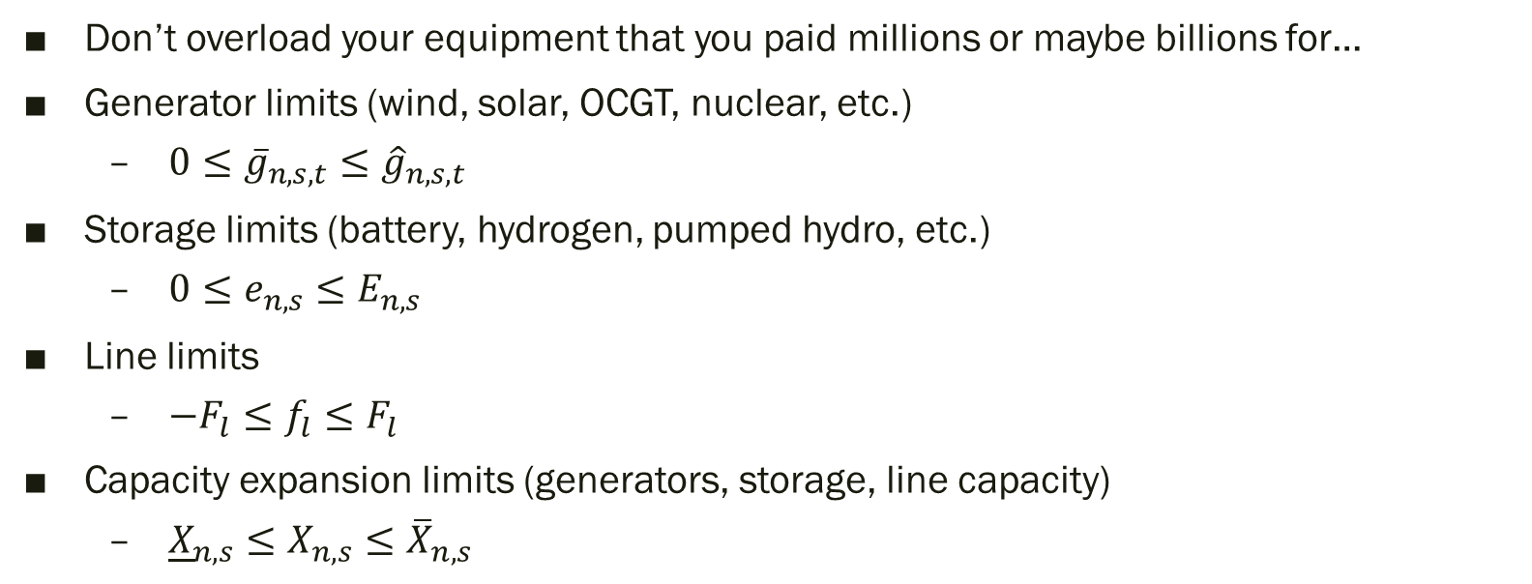
Constraints
Don’t overload your equipment that you paid millions or maybe billions for…
Generator limits (wind, solar, OCGT, nuclear, etc.)
$0≤{\overline{g}}_{n,s,t}≤{\hat{g}}_{n,s,t}$
Storage limits (battery, hydrogen, pumped hydro, etc.)
$0≤e_{n,s}≤E_{n,s}$
Line limits
$−F_{l}≤f_{l}≤F_{l}$
Capacity expansion limits (generators, storage, line capacity)
${\underline{X}}_{n,s}≤X_{n,s}≤{\overline{X}}_{n,s}$

Slide 6
The Inputs
Onshore wind and solar capacity factors data collected from model.energy
2011 – 2014 data is available
Selected Washington State as location due to proximity to BC
Hourly resolution
Load data from BC Hydro Historical Transmission Data – Gross Telemetered Load
BC Hydro Data
2014 used as the basis for Load Data
Hourly resolution
Technology data provided by PyPSA from GitHub
Includes VOM, FOM, Investment, CO₂ Intensity and many other data points for hundreds of technologies
Data is available for 2030 through 2050 in 5 years increments

Slide 7
Generators and Storage Considered
Generation Technologies
OCGT – Open Cycle Gas Turbines
Hydroelectricity
Nuclear
Wind
Solar
Storage Technologies
Pumped Hydro
Battery Storage

Slide 8
Scenarios – What can we change
Load
Investment Cost
Fuel Cost
Carbon Cost
Generation
Types of generation available
Maximum or minimum amount of nominal power acceptable in solution
CO₂ emissions limits

Slide 9
Scenario 1 - Year 2030
Nuclear and Hydro Available
Carbon market is available, but the cost of carbon is $150 CAD / tonne CO_{2e*}
*CO_{2e} is CO₂-equivalent GHG
Can build as much wind and solar as we want, but we must have a 1-1 ratio with energy storage
Power increases 2% year-over-year

Slide 10
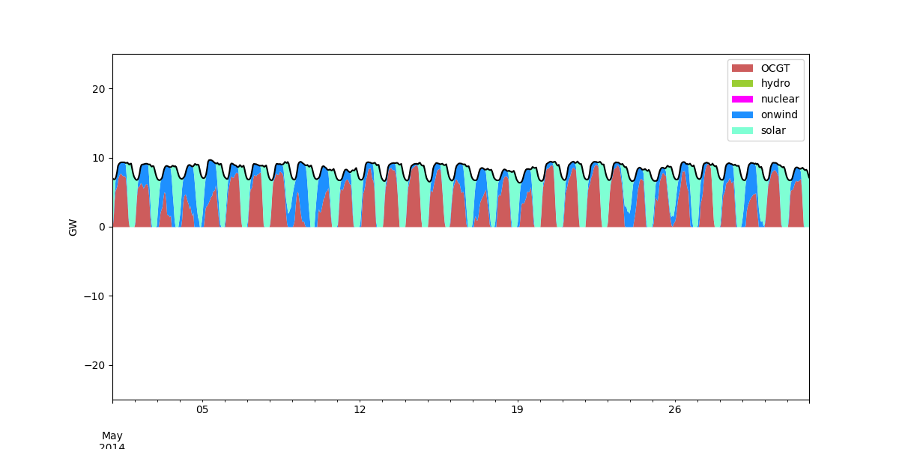
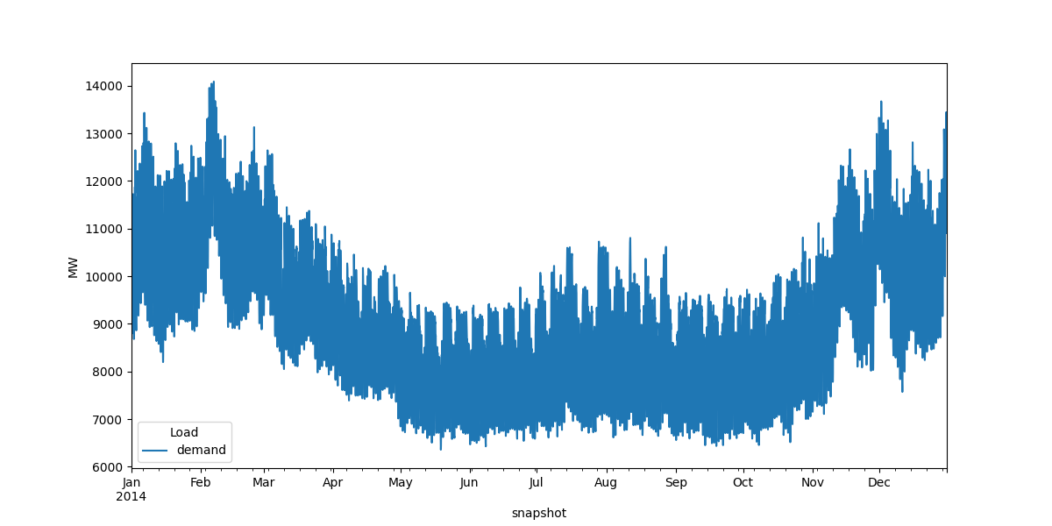
Scenario 1 - Year 2030

Slide 11
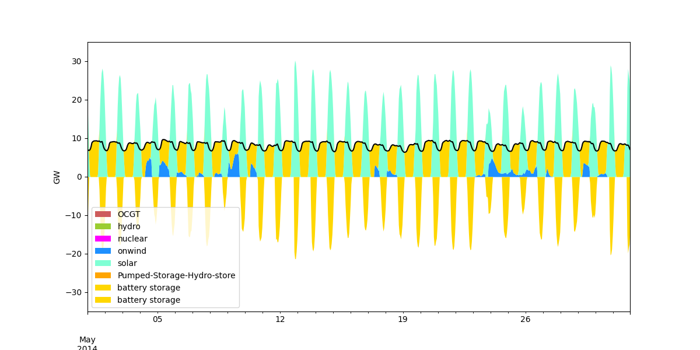
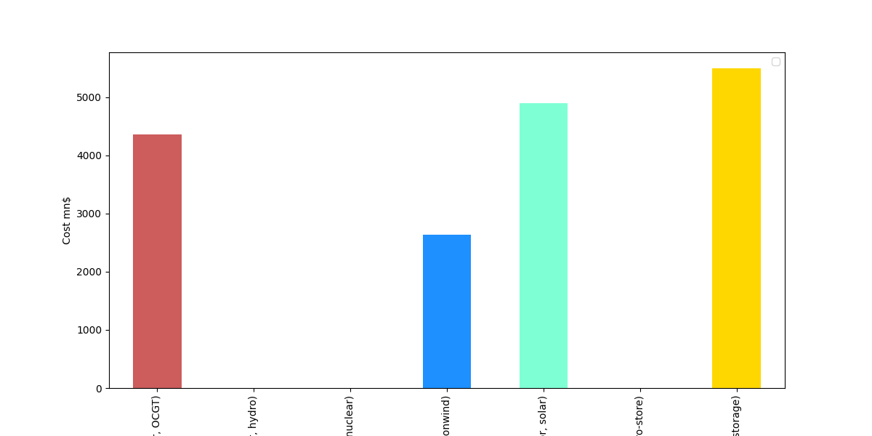
Scenario 1 - Year 2030
Capacities :
OCGT– 6891 MW
Onwind – 10646 MW
Solar – 40648 MW
Battery Storage – 31722 MW
System Cost:
$17.4 billion CAD

Slide 12
Scenario 2 – Year 2040
Nuclear and Hydro Available
Carbon market is available, but the cost of carbon is $500 CAD / tonne CO_{2e*}
*CO_{2e} is CO₂-equivalent GHG
Can build as much wind and solar as we want, but we must have a 1-1 ratio with energy storage
Power increases 2% year-over-year

Slide 13
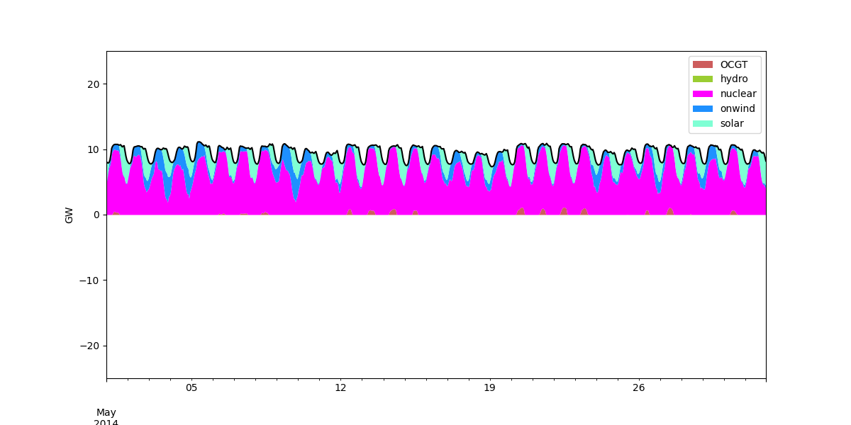

Scenario 2 – Year 2040

Slide 14
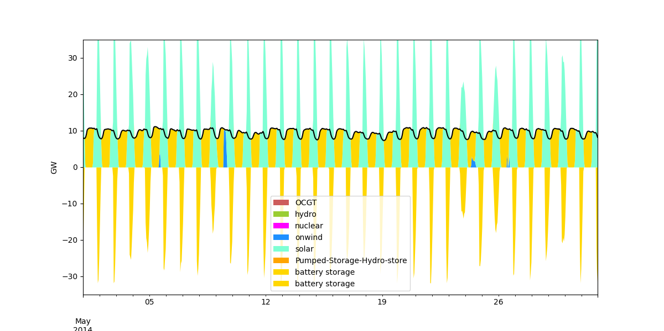
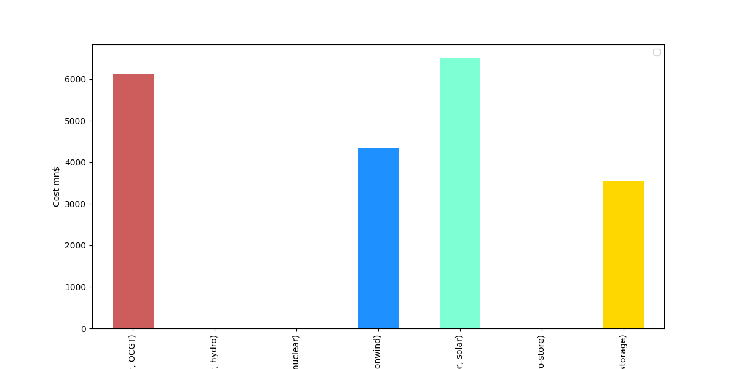
Scenario 2 – Year 2040
Capacities :
OCGT– 7307 MW
Onwind – 18649 MW
Solar – 64882 MW
Battery Storage – 31802 MW
System Cost:
$20.5 billion CAD

Slide 15
Scenario 3 – Year 2050
Nuclear and Hydro Available
Carbon emissions must be zero
Can build as much wind and solar as we want – energy storage constraint is relaxed
Power increases 2% year-over-year

Slide 16
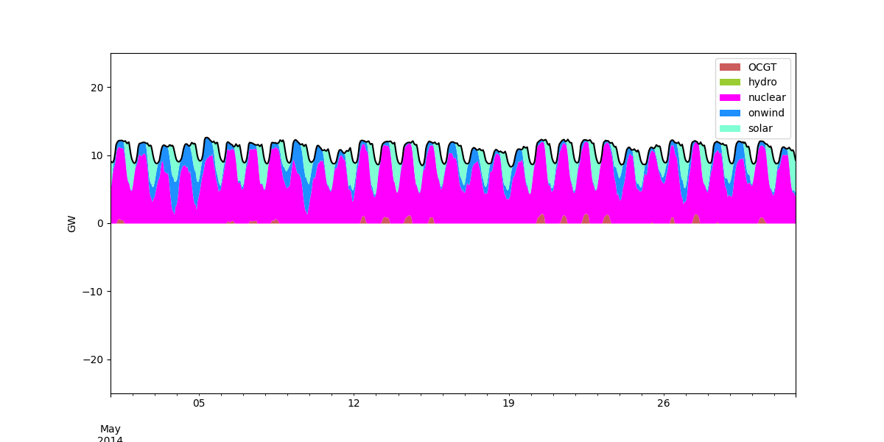

Scenario 3 – Year 2050

Slide 17
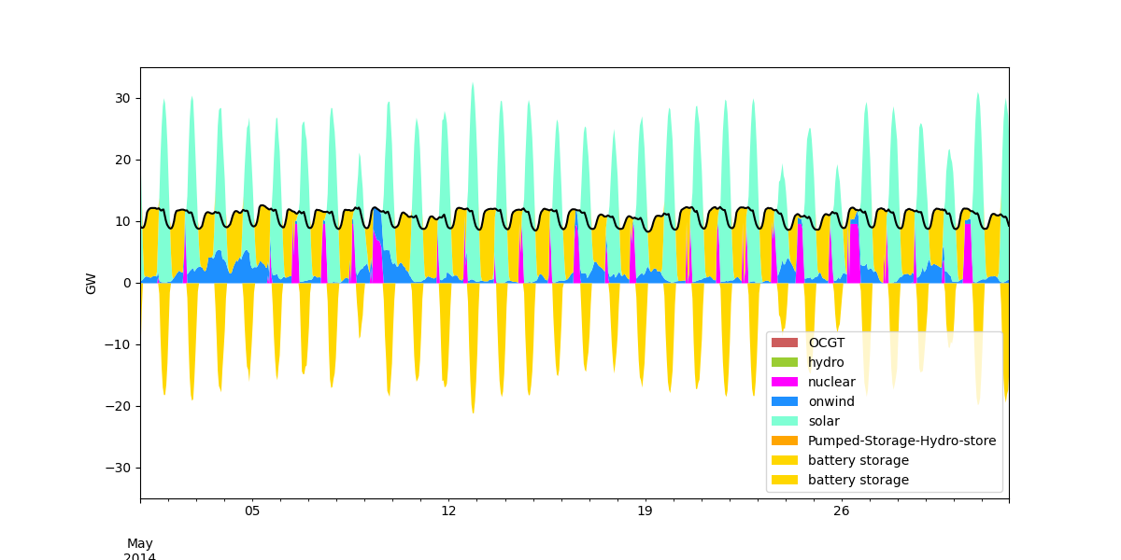
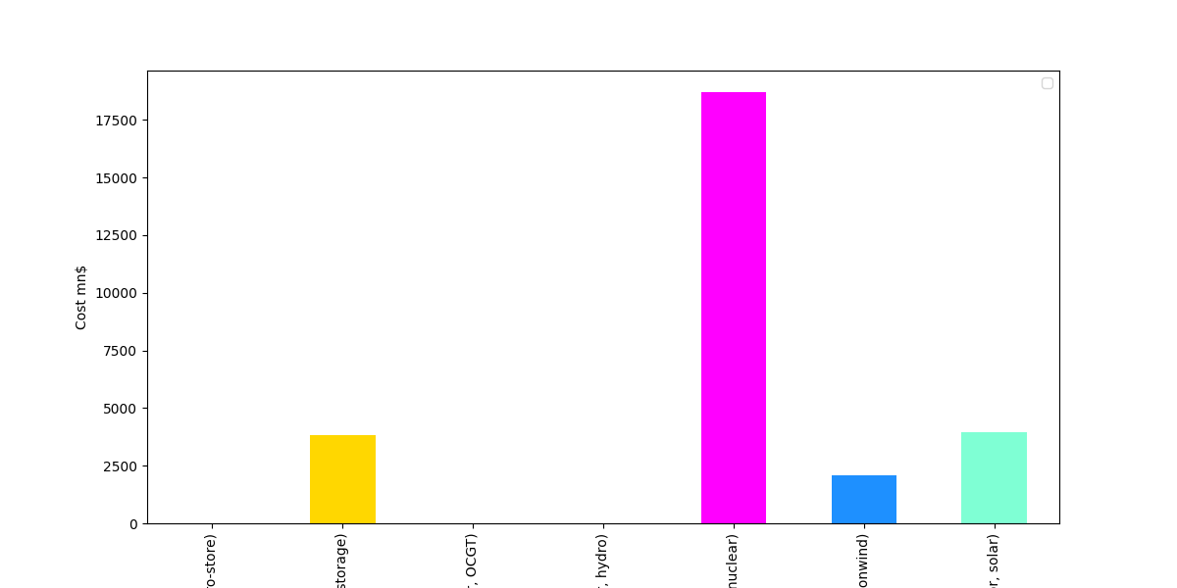
Scenario 3 – Year 2050
Capacities :
Nuclear– 9630 MW
Onwind – 8981 MW
Solar – 43147 MW
Battery Storage – 45436 MW
System Cost:
$28.5 billion CAD

Slide 18
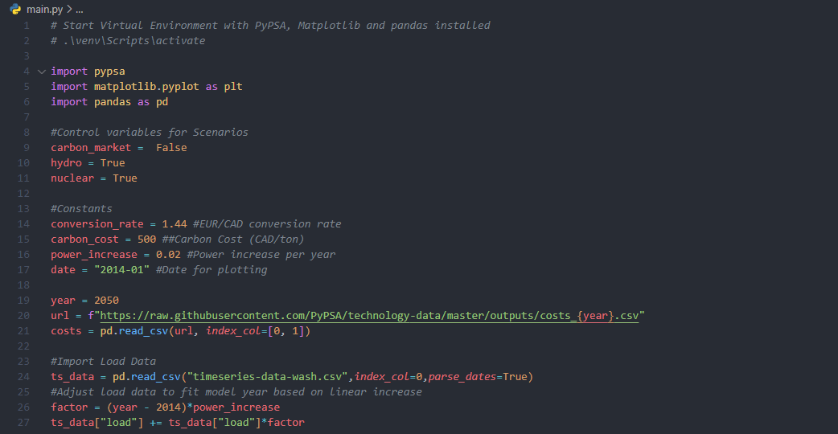
In-class demo

Slide 19
Proposed Model Revisions
Increase the accuracy of data
Load data, for instance, can be difficult to forecast but is critical to get right when planning capacity
Technology data – investment cost, lifetime, RoR, efficiency, etc.
Markets and regulation
Changes to the energy market or regulatory environment and their effects
Stochastics
Account for random variance in one or more parameters over time
Hourly dispatch to account for reliability and Effective Load Carrying Capacity (ELCC) of various technologies to ensure cost-effective reliable supply while accounting for variable nature of solar and wind resources
Transmission
Capacity limits, cost of new infrastructure and losses

Slide 20
Thanks for listening

